Slide 1
Multicommodity Flows Network Flows Final Project Presentation
Alyssa Newman and Zane Showalter-Castorena

Slide 2
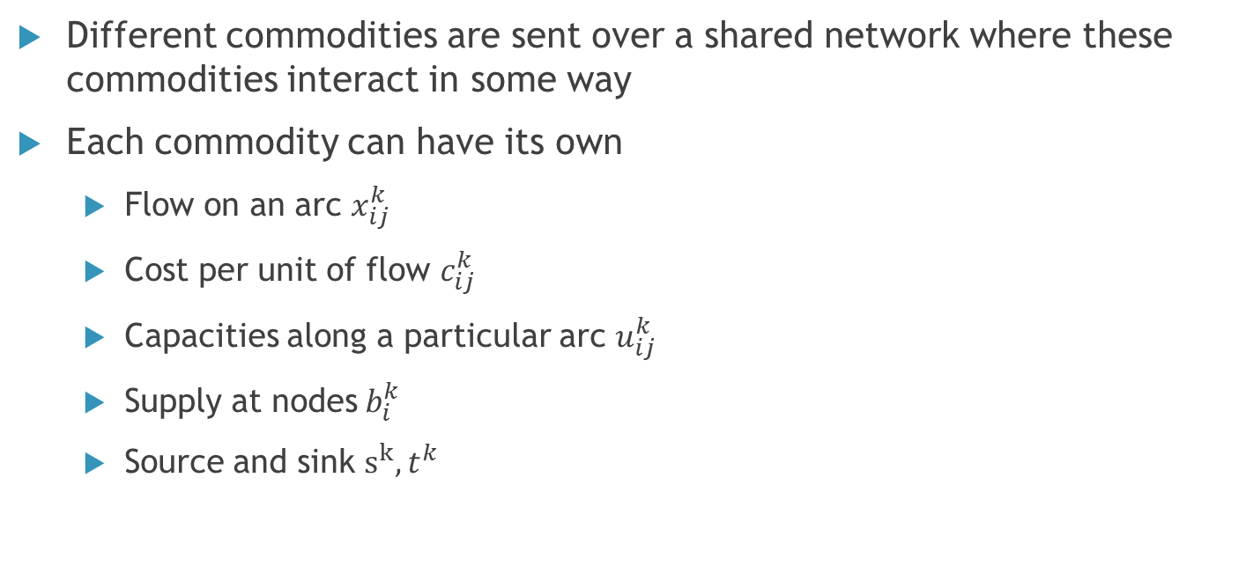
What is a Multicommodity Flow?
Different commodities are sent over a shared network where these commodities interact in some way
Each commodity can have its own
Flow on an arc $x_{ij}^{k}$
Cost per unit of flow $c_{ij}^{k}$
Capacities along a particular arc $u_{ij}^{k}$
Supply at nodes$b_{i}^{k}$
Source and sink $s^{k}, t^{k}$
Notes:
Can still have overall capacities and supplies in addition

Slide 3
Why Do We Care?
Jobs
Research
Applications
Trains
Scheduling
Networking
Dynamic traffic assignment
Distribution systems
Bandwidth packing problem

Slide 4
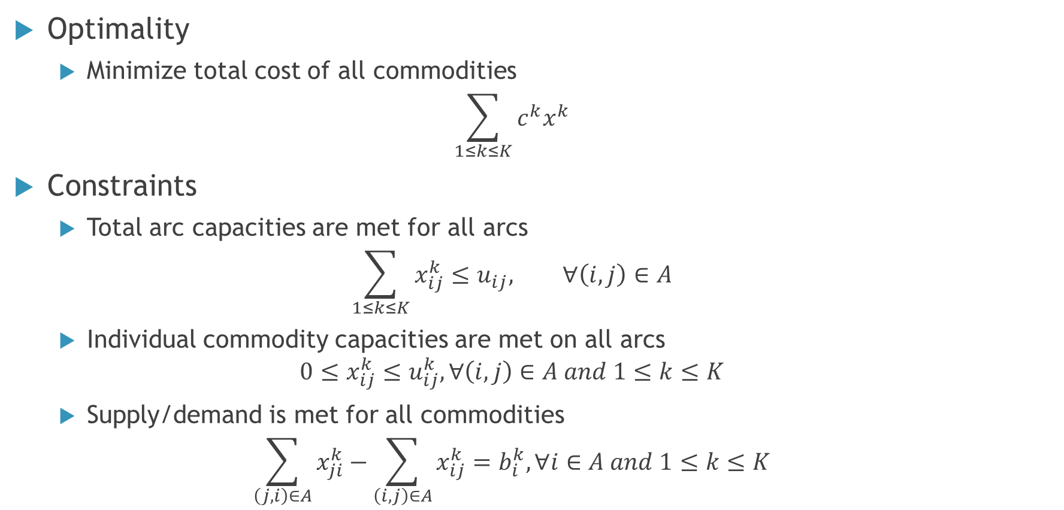
Equations
Optimality
Minimize total cost of all commodities
$$\sum_{1≤k≤K}{c^{k}x^{k}}$$
Constraints
Total arc capacities are met for all arcs
$$\sum_{1≤k≤K}{x_{ij}^{k}}≤u_{ij}, ∀\left(i,j\right)∈A$$
Individual commodity capacities are met on all arcs
$$0≤x_{ij}^{k}≤u_{ij}^{k}, ∀\left(i,j\right)∈A and 1≤k≤K$$
Supply/demand is met for all commodities
$$\sum_{\left(j,i\right)∈A}{x_{ji}^{k}}−\sum_{\left(i,j\right)∈A}{x_{ij}^{k}}=b_{i}^{k}, ∀i∈A and 1≤k≤K$$
Notes:
Optimization equ is for min cost flow, can have a different one for max flow

Slide 5
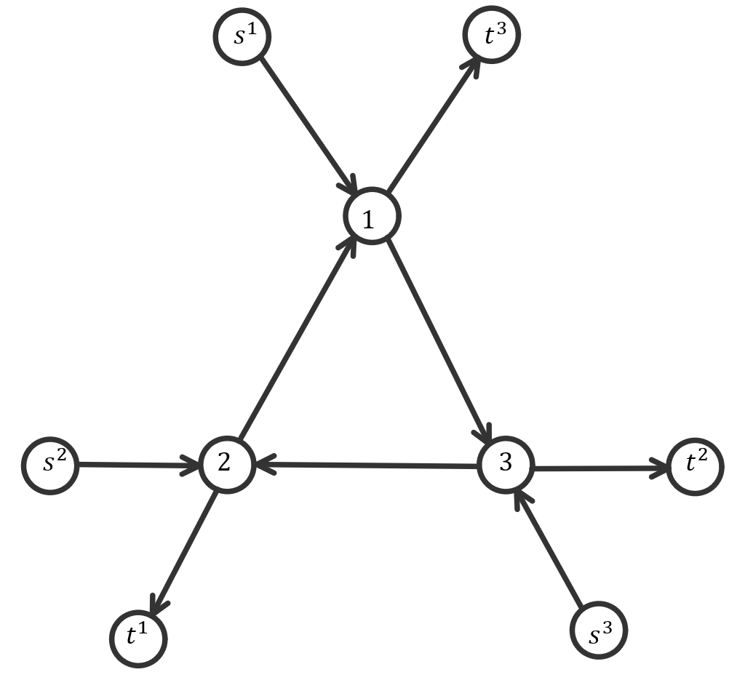
Complicating Factors
Having integer valued parameters no longer means we have an integer valued max flow
All arcs have bundle capacity 1
Want to maximize the total flow
Notes:
If limited to integer one of the commodities would have flow of 1 and the other two would have zero flow.

Slide 6


Complicating Factors
Having integer valued parameters no longer means we have an integer valued max flow
All arcs have bundle capacity 1
Want to maximize the total flow
.5
.5
.5
.5
Notes:
If limited to integer one of the commodities would have flow of 1 and the other two would have zero flow.

Slide 7


Complicating Factors
Having integer valued parameters no longer means we have an integer valued max flow
All arcs have bundle capacity 1
Want to maximize the total flow
.5
.5
.5
.5
.5
.5
.5
.5
Notes:
If limited to integer one of the commodities would have flow of 1 and the other two would have zero flow.

Slide 8


Complicating Factors
Having integer valued parameters no longer means we have an integer valued max flow
All arcs have bundle capacity 1
Want to maximize the total flow
.5
.5
.5
.5
.5
.5
.5
.5
.5
.5
.5
.5
Notes:
If limited to integer one of the commodities would have flow of 1 and the other two would have zero flow.

Slide 9
Complicating Factors
One ‘unit’ of two commodities may not seem to use the same amount of an arc’s total capacity
Inconsistency with what our ‘simplifying assumptions’ should be
Notes:
Capacity difference:
Shipping 1 lb of feathers and shiping 1 lb of bricks don’t take up the same amount of room in a truck
What simplifying assumption:
Do integer solutions make since? Do individual capacities make since? Bundle capacities? Both?

Slide 10
General Complexity Of The Problem
If want to produce integer flow satisfying all demands is NP-complete, even for 2 commodities
Takes polynomial time to verify if an answer is correct
If fractions are allowed they can be solved in polynomial time using LP techniques
If approximate answers suffice then they can be solved much faster with each iteration getting a better approximate
Notes:
np- can also be interpreted as it can be solved in polynomial time only on a ‘non-deterministic’ computer that can run things simultaneously or somehow guess the right answer.

Slide 11
Methods Of Solving Multicommodity Flows
Price-directive decomposition
Resource-directive decomposition
Partitioning methods

Slide 12
Price Directive Decomposition
Decompose problem into k subproblems
Solve by running a minimum cost algorithm on each of the k subproblems
Resource Driven Decomposition
Decompose the problem into k subproblems
Solve each subproblem sequentially, then use LP methods to ‘tie’ the solutions back together
Partitioning Methods
Exploit the fact that multicommodity flow problem is a specially structured LP
Solve a linear program with embedded network flow problems, using the network simplex method

Slide 13
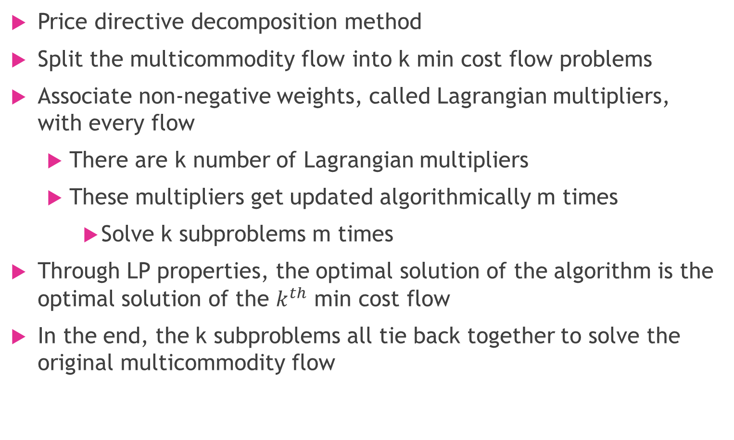
Lagrangian Relaxation
Price directive decomposition method
Split the multicommodity flow into k min cost flow problems
Associate non-negative weights, called Lagrangian multipliers, with every flow
There are k number of Lagrangian multipliers
These multipliers get updated algorithmically m times
Solve k subproblems m times
Through LP properties, the optimal solution of the algorithm is the optimal solution of the $k^{th}$ min cost flow
In the end, the k subproblems all tie back together to solve the original multicommodity flow
Notes:
Complexity

Slide 14
Column Generation
Advanced Linear Programing technique for problems with extremely large number of variables
Assumptions
Each commodity has a single source & sink node, and a single flow requirement between them
The only bound on a flow of a commodity through an arc is the maximum capacity of all commodities through that arc
For every commodity, the cost of every cycle is non-negative
Decompose the problem into k subproblems and transform the network into a path and cycle flows network
Use linear programming to solve each problem, then tie back together

Slide 15
Resource Directive Decomposition
All commodities are competing for fixed capacity of an arc
Decompose the problem into k subproblem
Allocate total capacity across all commodities to individual commodities
Rather than solve the original problem directly, it is transformed into a problem that is easier to solve
Solution methods include
Heuristic methods “arc at a time” approach
Subgradiant optimization methods - LP

Slide 16
Application – Railroad Transportation
Nodes represent yards and junction points
Arcs represent tracks between yards
Demand represented as number of cars per train
Different goods can be loaded, each with their own demand and cost
Notes:
Move to earlier near when define what multi-com is

Slide 17
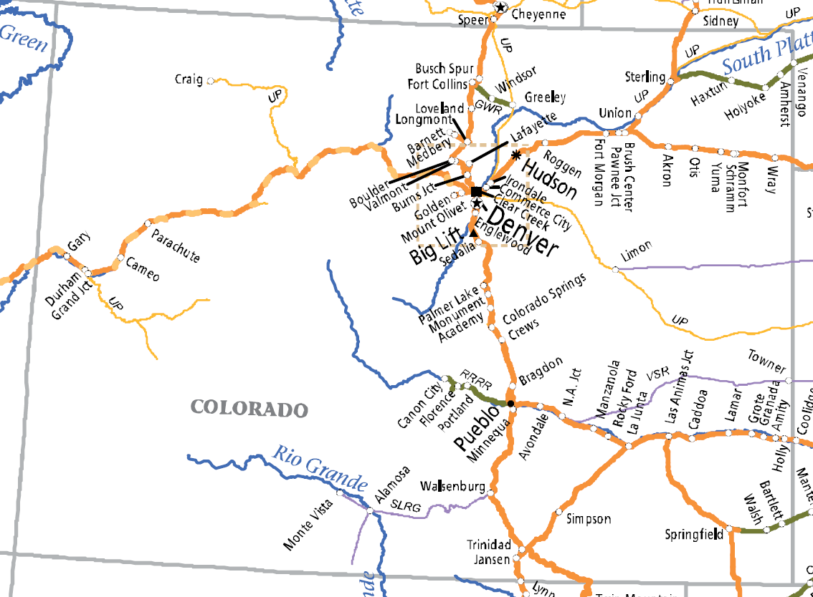
Application – Railroad Transportation

Slide 18
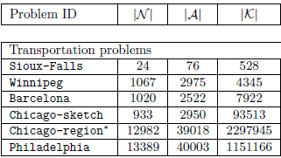

Application – Railroad Transportation
Solving large scale linear multicommodity flow problems with an active set strategy and Proximal-ACCPM
Formulated as a linear program combined with optimization criteria
Result is a numerical solution
$𝒩$ = Nodes, $𝒜$ = Arcs, $𝒦$= Commodities

Slide 19

Another application
Scheduling
Minimize cost to schedule all positions
People and/or assignments can be nodes
Feasible assignments are arcs
Demand represents number of workers needed
Different types of workers or different shifts are commodities
Notes:
A lot of work was done on this topic by American airlines to minimize the cost of having all the flights fully maned

Slide 20
Teaching allocations example problem
Simplified example
Two time slots: morning and afternoon
3 teachers: Alice, Bob, Carol
Alice only available in the morning, Bob only available In the afternoon, Carol is always available
4 classes: class 1, class 2, class 3, and class 4
Classes 1 and 4 can only be offered in the morning, class 2 can only be offered in the afternoon, class 3 can be offered in either time slot
Teachers all have the following preferences in descending order
Alice: class 2, class 1, class 4, class 3
Bob: class 1, class 3, class 2, class 4
Carol: class 2, class 4, class 1, class 3
Notes:
Specifically a simplified time table problem

Slide 21
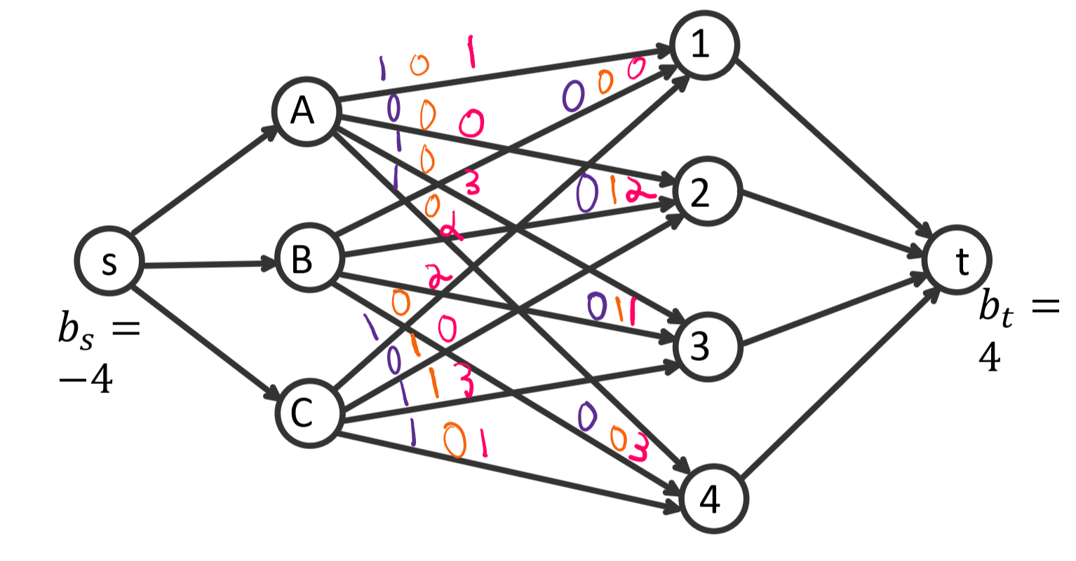
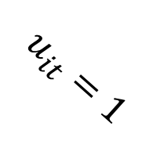

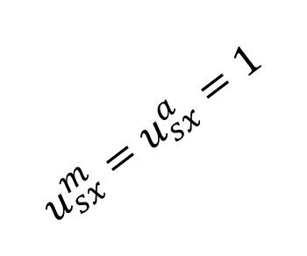
$u_{xi}^{m} u_{xi}^{a} c_{ij}$
$$u_{sx}^{m}=u_{sx}^{a}=1$$
$$u_{it}=1$$
Notes:
UxiT=1 iff both teacher and class are available at that time.
Goal: max flow
Improved by:
Adding costs on arcs xi for preferences, full time employees can be given a demand, sx arcs can be given costs for different salaries

Slide 22

$u_{xi}^{m} u_{xi}^{a} c_{ij}$
$$u_{sx}^{m}=u_{sx}^{a}=1$$
$$u_{it}=1$$
Notes:
UxiT=1 iff both teacher and class are available at that time.
Goal: max flow
Improved by:
Adding costs on arcs xi for preferences, full time employees can be given a demand, sx arcs can be given costs for different salaries

Slide 23

$u_{xi}^{m} u_{xi}^{a} c_{ij}$
$$u_{sx}^{m}=u_{sx}^{a}=1$$
$$u_{it}=1$$
Notes:
UxiT=1 iff both teacher and class are available at that time.
Goal: max flow
Improved by:
Adding costs on arcs xi for preferences, full time employees can be given a demand, sx arcs can be given costs for different salaries

Slide 24

$u_{xi}^{m} u_{xi}^{a} c_{ij}$
$$u_{sx}^{m}=u_{sx}^{a}=1$$
$$u_{it}=1$$
Notes:
UxiT=1 iff both teacher and class are available at that time.
Goal: max flow
Improved by:
Adding costs on arcs xi for preferences, full time employees can be given a demand, sx arcs can be given costs for different salaries

Slide 25

$u_{xi}^{m} u_{xi}^{a} c_{ij}$
$$u_{sx}^{m}=u_{sx}^{a}=1$$
$$u_{it}=1$$
Notes:
UxiT=1 iff both teacher and class are available at that time.
Goal: max flow
Improved by:
Adding costs on arcs xi for preferences, full time employees can be given a demand, sx arcs can be given costs for different salaries

Slide 26
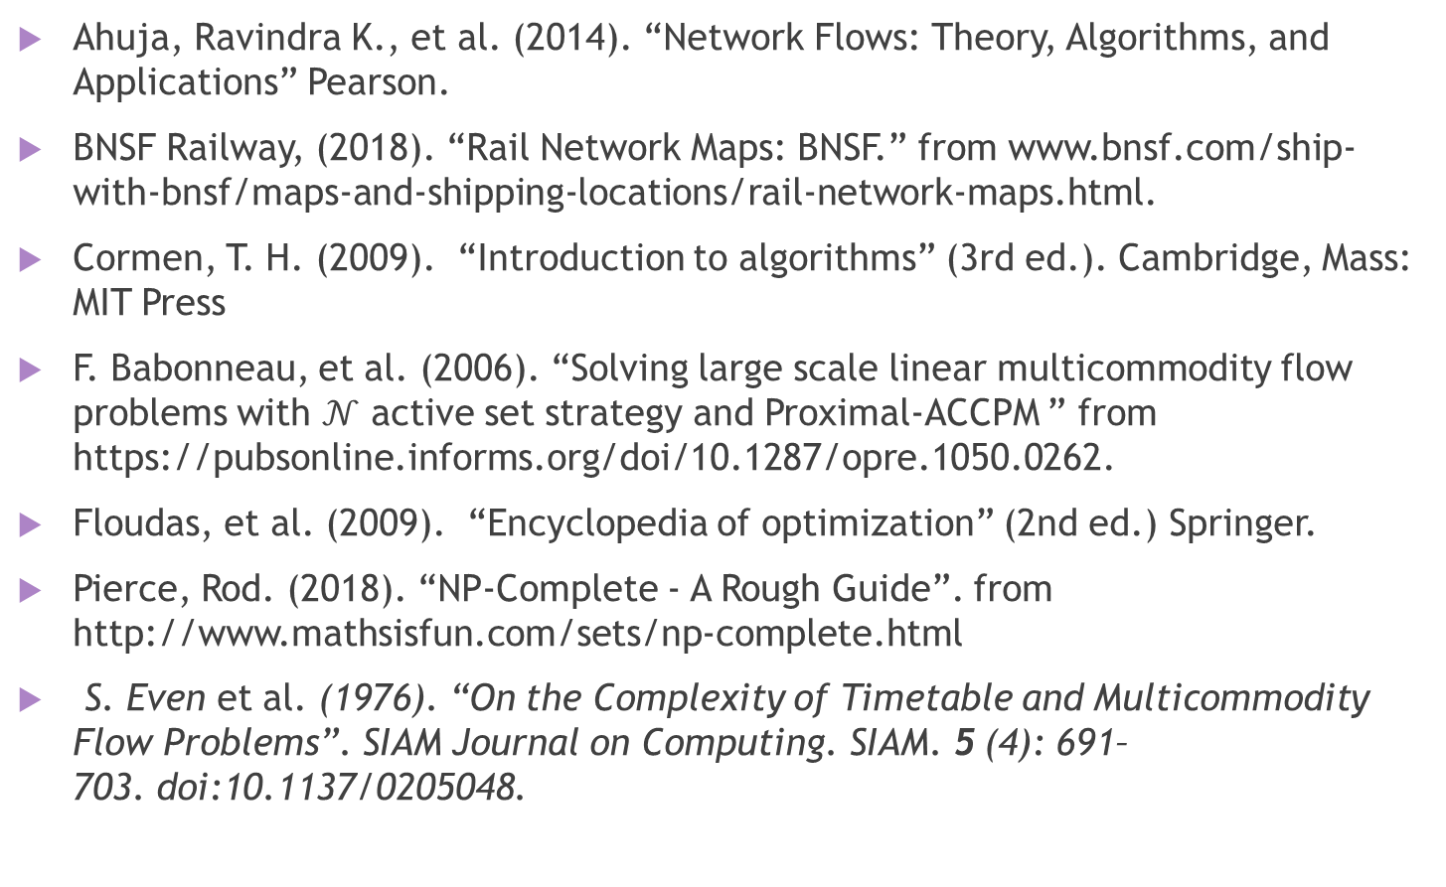
References
Ahuja, Ravindra K., et al. (2014). “Network Flows: Theory, Algorithms, and Applications” Pearson.
BNSF Railway, (2018). “Rail Network Maps: BNSF.” from www.bnsf.com/ship-with-bnsf/maps-and-shipping-locations/rail-network-maps.html.
Cormen, T. H. (2009). “Introduction to algorithms” (3rd ed.). Cambridge, Mass: MIT Press
F. Babonneau, et al. (2006). “Solving large scale linear multicommodity flow problems with $𝒩$ active set strategy and Proximal-ACCPM ” from https://pubsonline.informs.org/doi/10.1287/opre.1050.0262.
Floudas, et al. (2009). “Encyclopedia of optimization” (2nd ed.) Springer.
Pierce, Rod. (2018). “NP-Complete - A Rough Guide”. from http://www.mathsisfun.com/sets/np-complete.html
S. Even et al. (1976). “On the Complexity of Timetable and Multicommodity Flow Problems”. SIAM Journal on Computing. SIAM. 5 (4): 691–703. doi:10.1137/0205048.

Slide 27
Questions?

